Slide 1





Classification of speech sounds
AL- FARABI KAZAKH NATIONAL UNIVERSITY

Slide 2




OUTLINE OF DISCUSSION TOPICS
Introduction
The classification of vowels
The classification of consonants

Slide 3
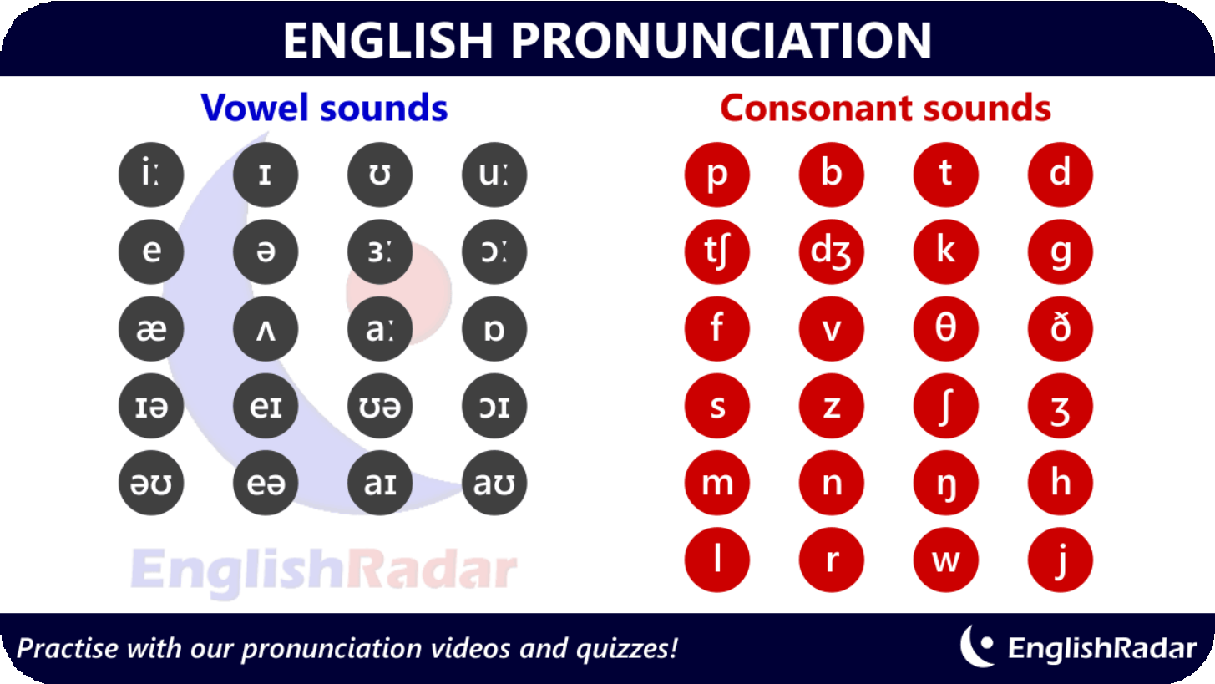

ENGLISH SPEECH SOUNDS:
. CONSONANTS
. VOWELS

Slide 4

THE CLASSIFICATION OF ENGLISH VOWELS
I N T H E S T A B I L I T Y O F A R T I C U L A T I O N
S T I N T H E T O N G U E P O S I T I O N
I N T H E L I P P O S I T I O N
I N T H E
C H A R A C T E R O F T H E V O W E L E N D
B E S I D E S T H A T V O W E L S D I F F E R
I N T H E I R L E N G T H

Slide 5
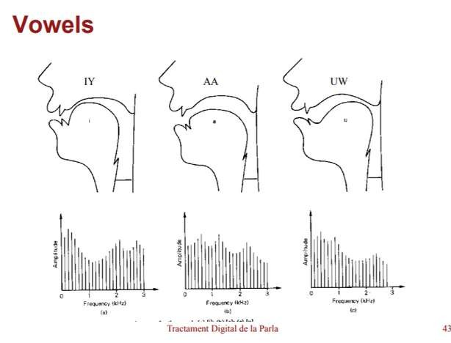


1. STABILITY
OF ARTICULATION
M O N O P H T H O N G S
The English monophthongs are: [ı], [e], [æ], [ ], [a:], [Ŋ],
[Ɔ:], [ʊ], [з:], [ә]
D I P H T H O N G S
The English diphthongs are: [eı], [aı], [Ɔı],
[aʊ], [əʊ], [eə], [ɪə], [ʊə]
D I P H T H O N G O I D S
There are two diphthongoids in English: [i:], [u:]

Slide 6




2. TONGUE POSITION
Front vowel [i:], [e], [æ] Front–retracted vowel [ı] Central vowel [L], [з:], [ә] Back vowel [a:], [Ŋ], [Ɔ:], [u:] Back–advanced vowel [ʊ]

Slide 7


3. LIP POSITION
T H E S H A P E O F T H E M O U T H C A V I T Y I S V E R Y D E P E N D E N T O N T H E P O S I T I O N O F T H E L I P S
UNROUNDED VOWELS: [ I :], [ I], [ E], [ Æ], [ A:],
[ З:], [ Ә]
ROUNDED VOWELS: [ Ŋ], [ Ɔ:], [ Ʊ], [ U:]

Slide 8



4. CHARACTER OF VOWEL END
THE QUALITY OF ALL ENGLISH
MONOPHTHONGS IN THE STRESSED
POSITION IS STRONGLY AFFECTED BY THE FOLLOWING CONSONANT OF THE SAME SYLLABLE.
I F A S T R E S S E D V O W E L I S F O L L O W E D B Y A S T R O N G
V O I C E L E S S C O N S O N A N T , I T I S C U T O F F B Y I T . I N T H I S C A S E T H E E N D O F T H E V O W E L I S S T R O N G ,
A N D T H E V O W E L I S C A L L E D C H E C K E D . E . G . B E T T E R , C A R T .
I F A V O W E L I S F O L L O W E D B Y A W E A K V O I C E D C O N S O N A N T O R B Y N O C O N S O N A N T A T
A L L , T H E E N D O F I T I S V E R Y W E A K , A N D T H E V O W E L I S C A L L E D F R E E . E . G . B E F O R E , M O N E Y , B E G G E R , B E A D .

Slide 9


VOWEL LENGTH
VOWELS ARE CAPABLE OF
BEING CONTINUED DURING A LONGER OR A SHORTER
PERIOD. ALL ENGLISH
VOWELS ( MONOPHTHONGS) ARE DIVIDED INTO LONG AND SHORT.
LONG VOWELS ARE: [I:], [A:], [Ɔ:], [U:], [З:].
SHORT VOWELS ARE: [I], [E], [Æ],
[ ], [Ŋ], [Ʊ], [Ә].

Slide 10
THE CLASSIFICATION OF ENGLISH CONSONANT

Slide 11

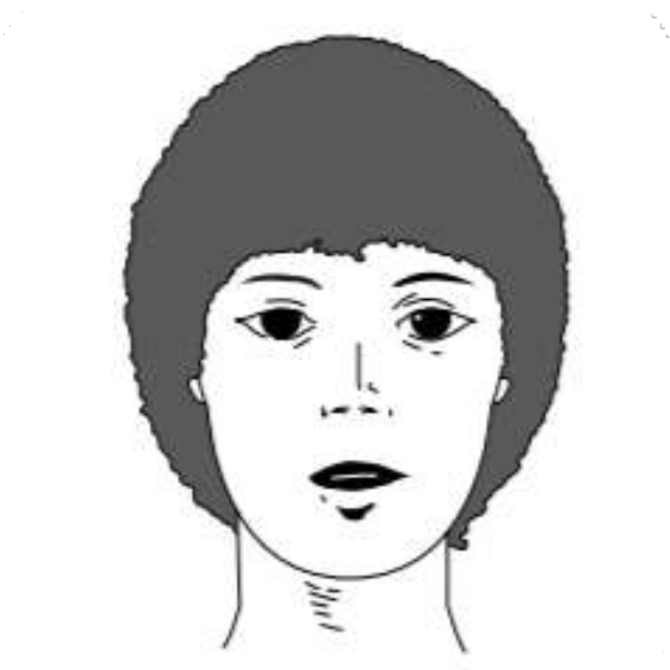
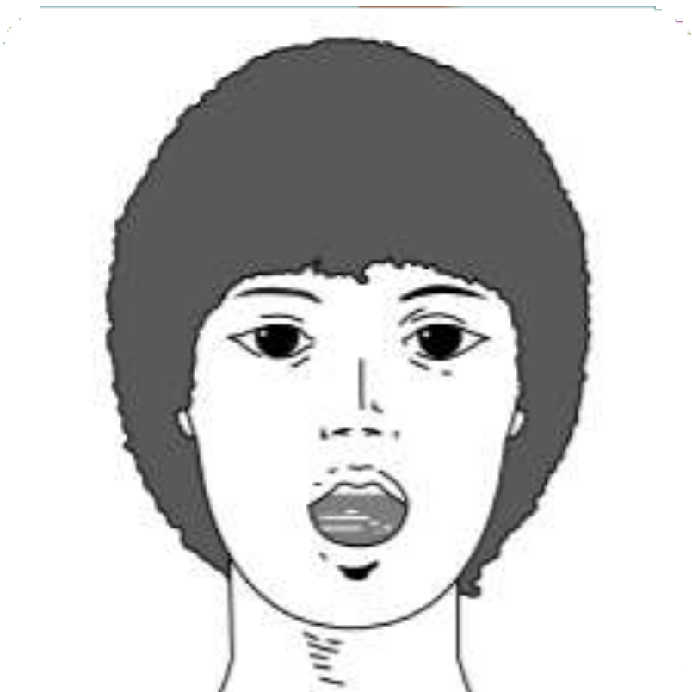
1. THE DEGREE OF NOISE
N O I S E
C O N S O N A N T S
S O N O R A N T S

Slide 12


Voiced Voiceless
in the work of the vocal
cords
NOISE CONSONANTS
in the degree
Strong Weak
of force of
articulation

Slide 13

SONORANTS
(OR SONOROUS CONSONANTS)
Sonorants are made with tone prevailing over noise because of a rather wide air passage.
They are: [m]‚ [n]‚ [ŋ]‚ [l]‚ [r]‚ [w]‚ [j]

Slide 14
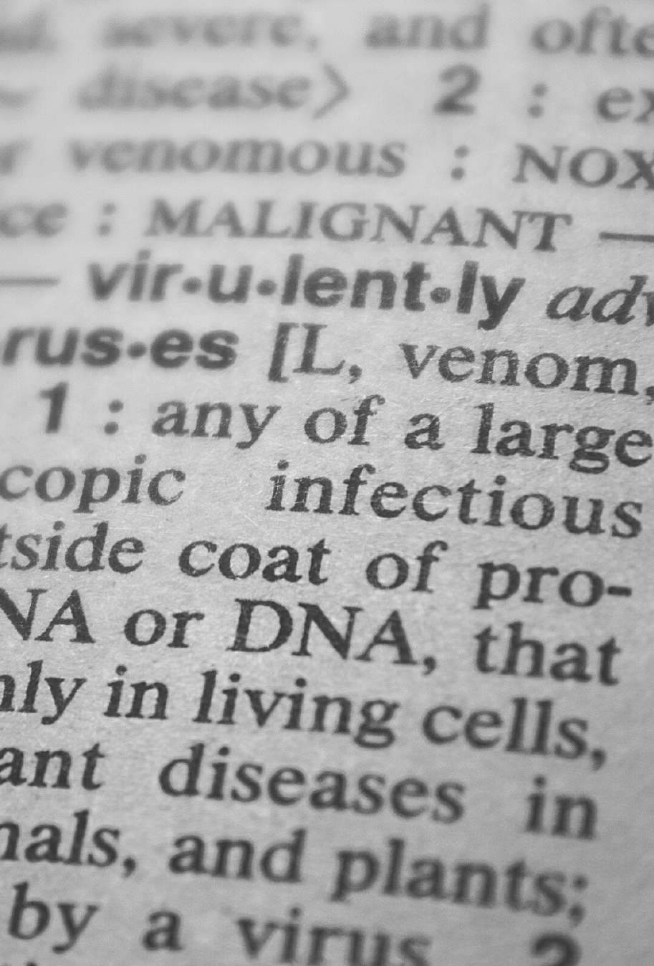

2. THE MANNER OF ARTICULATION
C O M P L E T E
[p]‚ [b]‚ [t]‚ [d]‚ [k]‚ [g]‚ [ʧ]‚ [ʤ]‚ [m]‚ [n]‚ [ŋ]
I N C O M P L E T E
[f]‚ [v]‚ [s]‚ [z]‚ [∫]‚ [ʒ]‚ [Ө]‚ [ð]‚ [h]‚ [l]‚ [r]‚ [w]‚ [j]
M O M E N T A R Y
[p]‚ [p']

Slide 15

ACCORDING TO THE MANNER OF ARTICULATION CONSONANTS MAY BE OF FOUR GROUPS:
O C C L U S I V E
C O N S T R I C T I V E
O C C L U S I V E - C O N S T R I C T I V E ( A F F R I C A T E S )
R O L L E D

Slide 16


1. OCCLUSIVE CONSONANTS
OCCLUSIVE NOISE CONSONANTS ARE CALLED STOPS, BECAUSE THE BREATH IS COMPLETELY STOPPED AT SOME POINT OF ARTICULATION.
AND THEN IT IS RELEASED WITH A SLIGHT EXPLOSION, THAT IS WHY THEY ARE ALSO CALLED PLOSIVES.

Slide 17

2. CONSTRICTIVE CONSONANTS
A C C O R D I N G T O T H E W O R K O F
T H E V O C A L C O R D S T H E Y M A Y B E
V O I C E D
( [ V ] ‚ [ Z ] ‚ [ Ʒ ] ‚ [ Ð ] )
V O I C E L E S S
( [ F ] ‚ [ S ] ‚ [ ∫ ] ‚ [ Ө ] ‚ [ H ] )

Slide 18
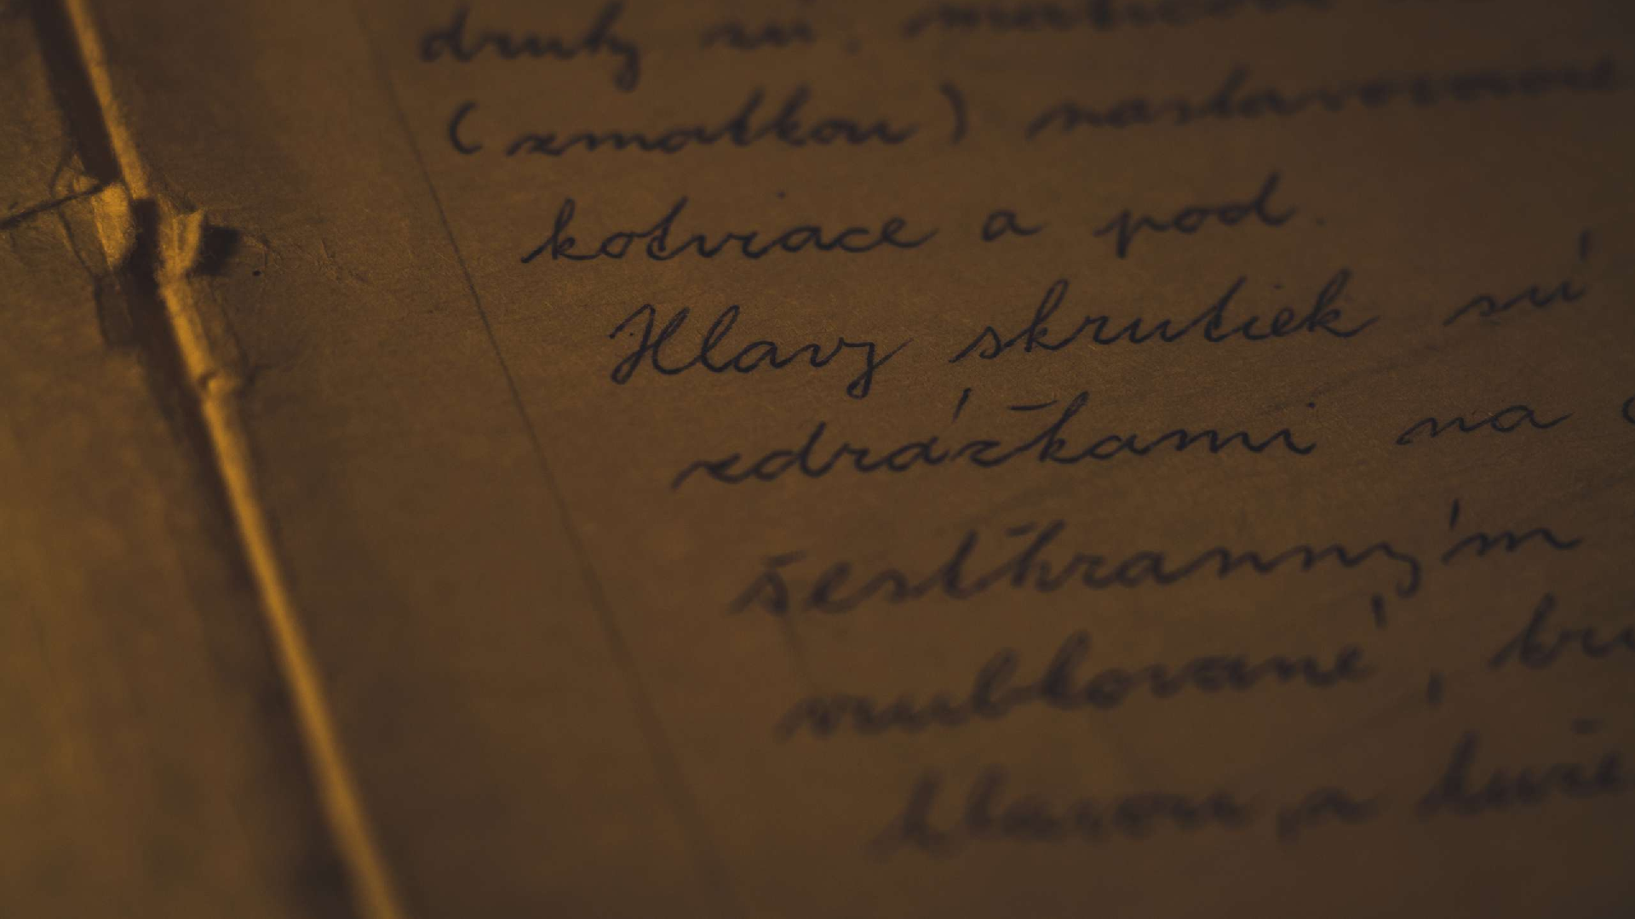


3 . OCCLUSIVE- CONSTRICTIVE
There are only two occlusive-constrictives in English: [ʧ] which is voiceless and strong (fortis) and [ʤ] which is voiced and weak (lenis). Affricates are oral according to the position of the soft palate.

Slide 19


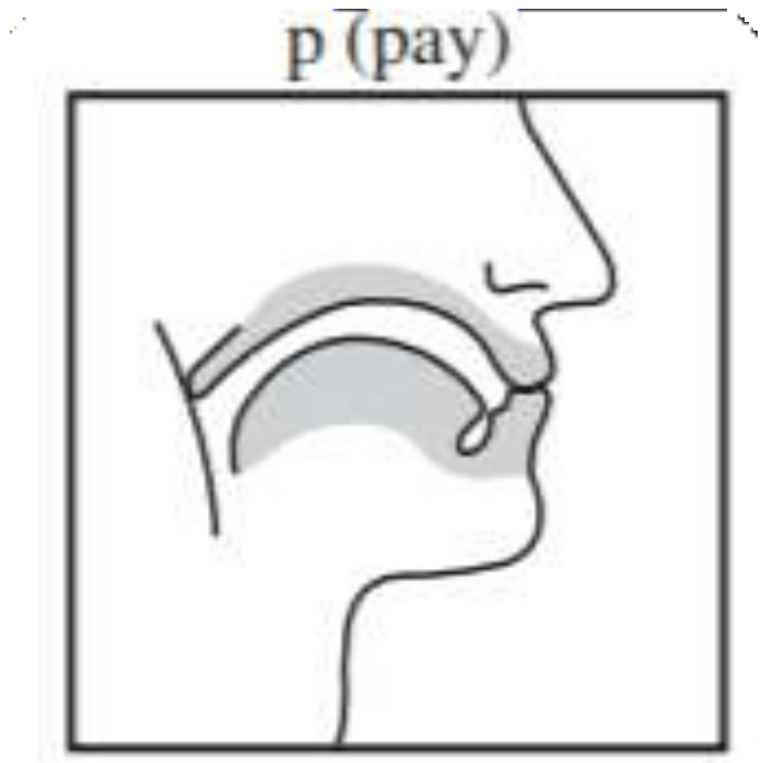


4. ROLLED CONSONANTS
T H E Y A R E T H E
R U S S I A N [ P ] ‚ [ P ' ] .

Slide 20

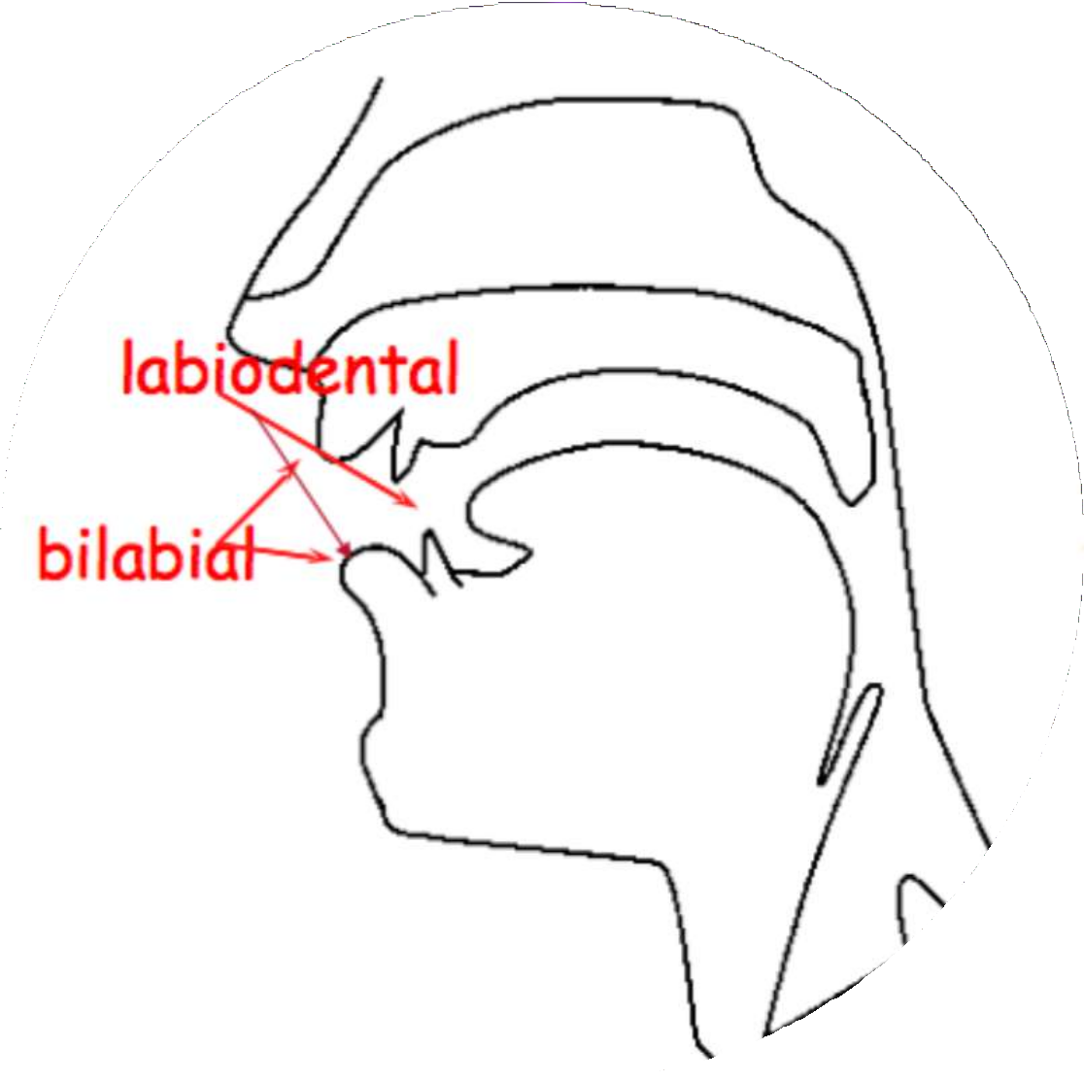
3. THE PLACE OF ARTICULATION
LABIAL CONSONANTS ARE MADE BY THE LIPS.
B I L A B I A L C O N S O N A N T S A R E : [ P ] ‚ [ B ] ‚ [ M ] ‚ [ W ]
L A B I O - D E N T A L C O N S O N A N T S A R E : [ F ] ‚ [ V ]

Slide 21

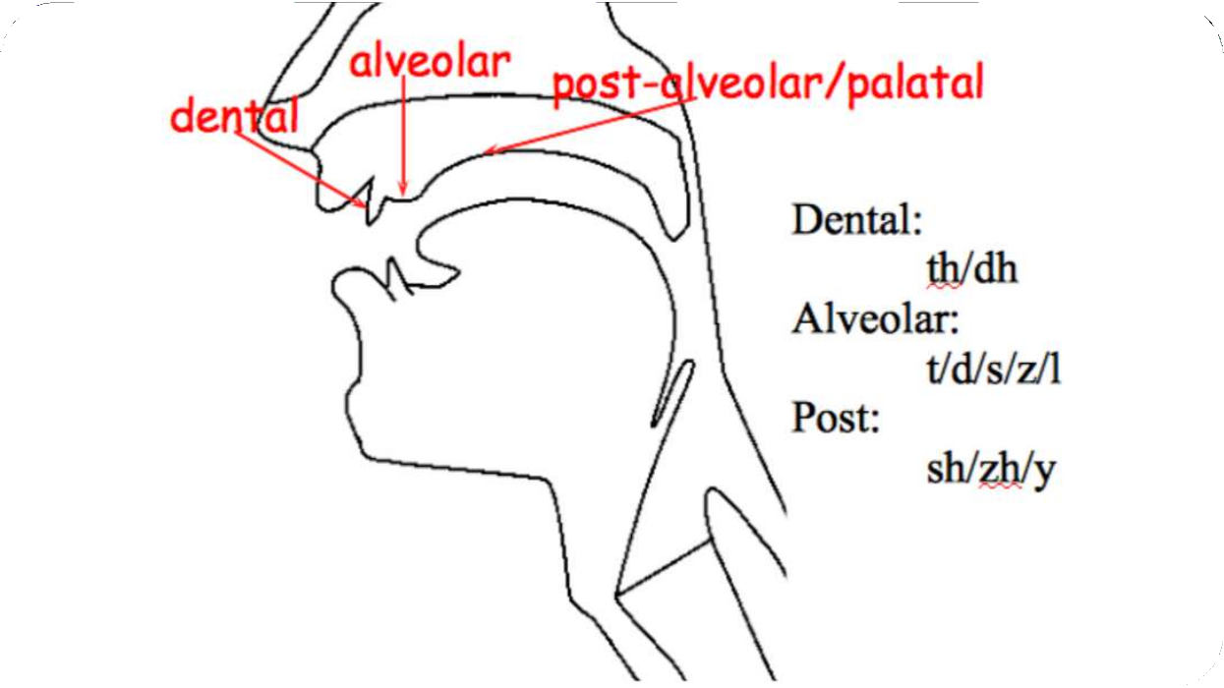
I N T E R D E N T A L C O N S O N A N T S : [ Ө ] ‚ [ Ð ]
D E N T A L C O N S O N A N T S O R D E N T A L S A R E : T H E R U S S I A N [ Т ] , [ Д ]
A L V E O L A R C O N S O N A N T S : [ T ] ‚ [ D ] ‚ [ S ] ‚
[ Z ] ‚ [ N ] ‚ [ L ]
P O S T – A L V E O L A R C O N S O N A N T S : [ R ]
P A L A T O – A L V E O L A R C O N S O N A N T S : [ ʧ ] ‚ [ ʤ ] ‚ [ ∫ ] ‚ [ Ʒ ]

Slide 22


THANK YOU FOR ATTENTION
:

